Slide 1
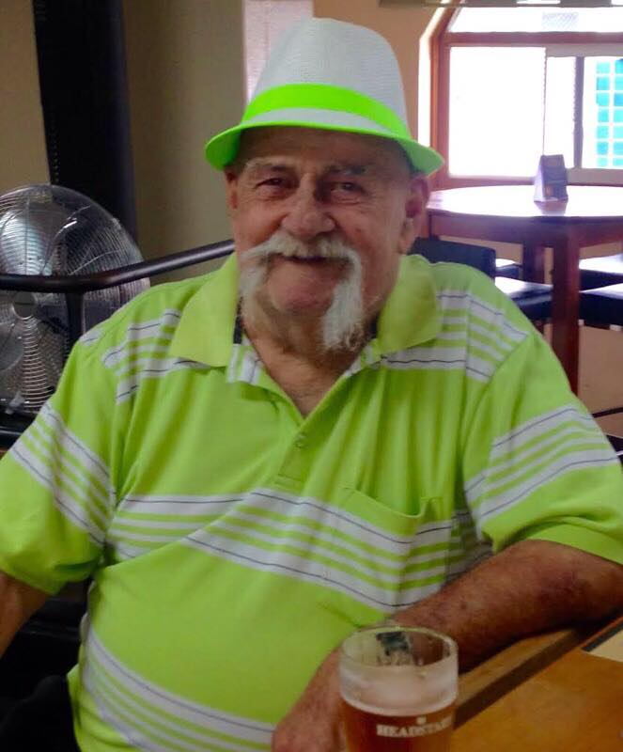
Barry Ronald Dudley
31st October 1936 – 12th November 2018
“Uncle Baz”

Slide 2
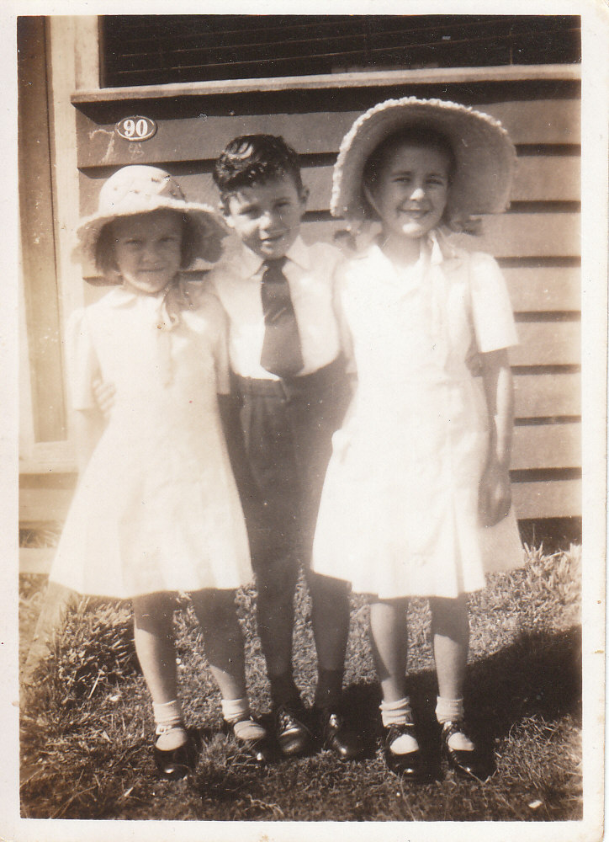
Barry Ronald Dudley – 31 Oct 1936 – 12 Nov 2018

Slide 3
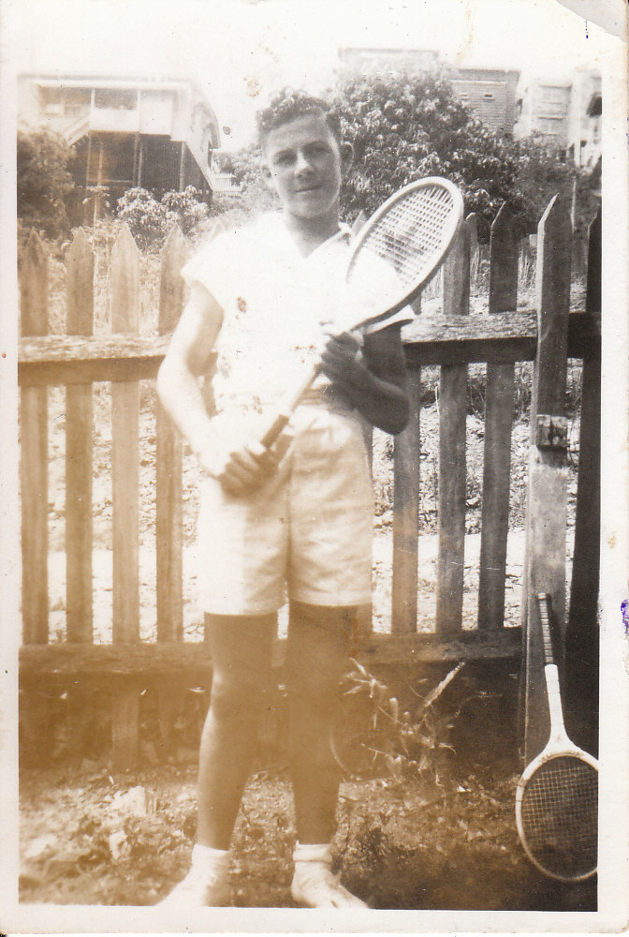
Barry Ronald Dudley – 31 Oct 1936 – 12 Nov 2018

Slide 4
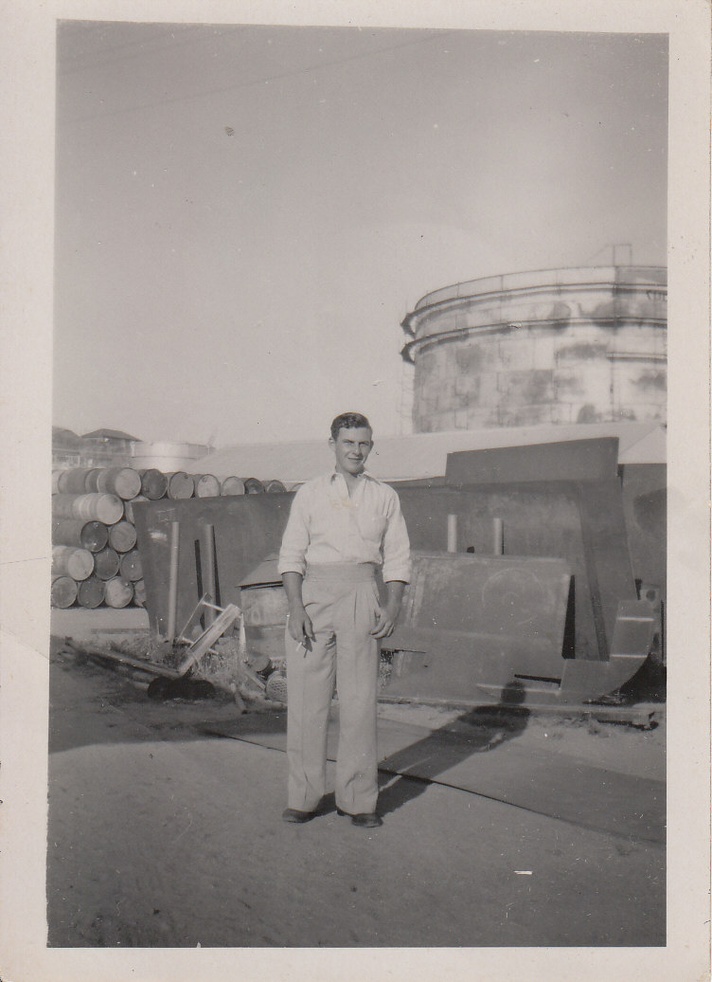
Barry Ronald Dudley – 31 Oct 1936 – 12 Nov 2018

Slide 5
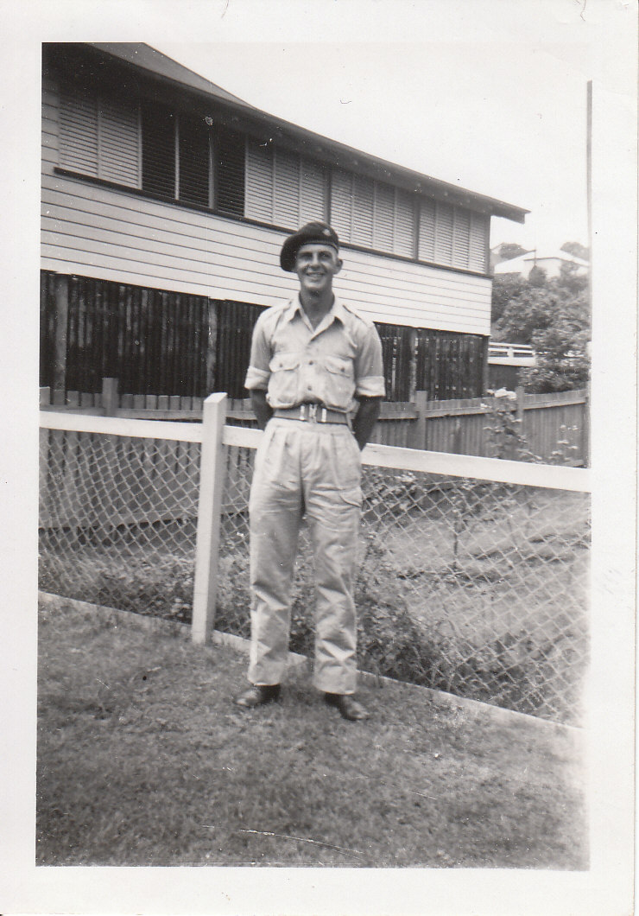
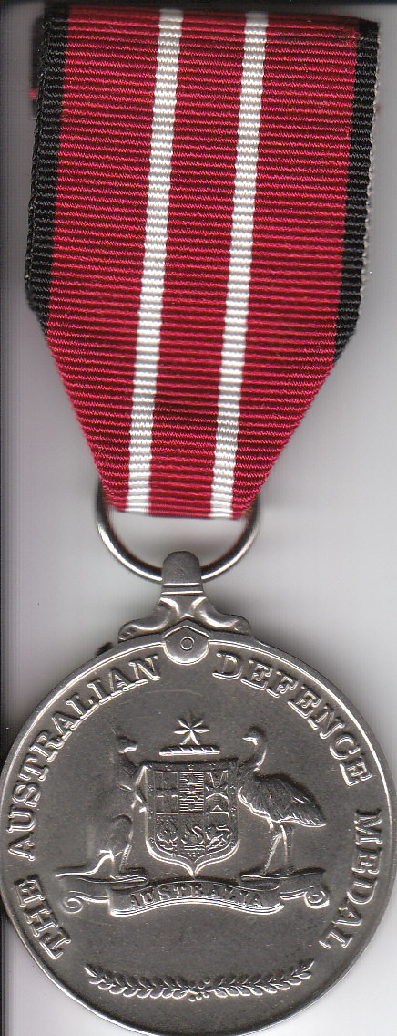
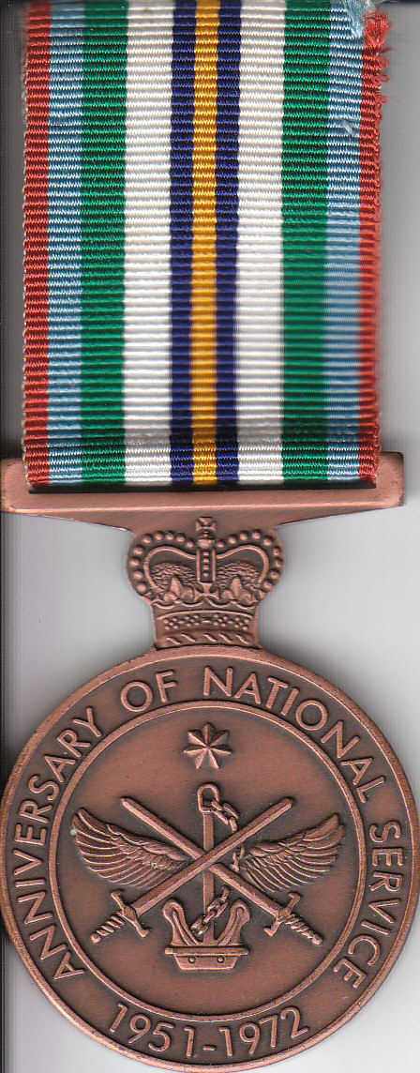

Barry Ronald Dudley – 31 Oct 1936 – 12 Nov 2018

Slide 6
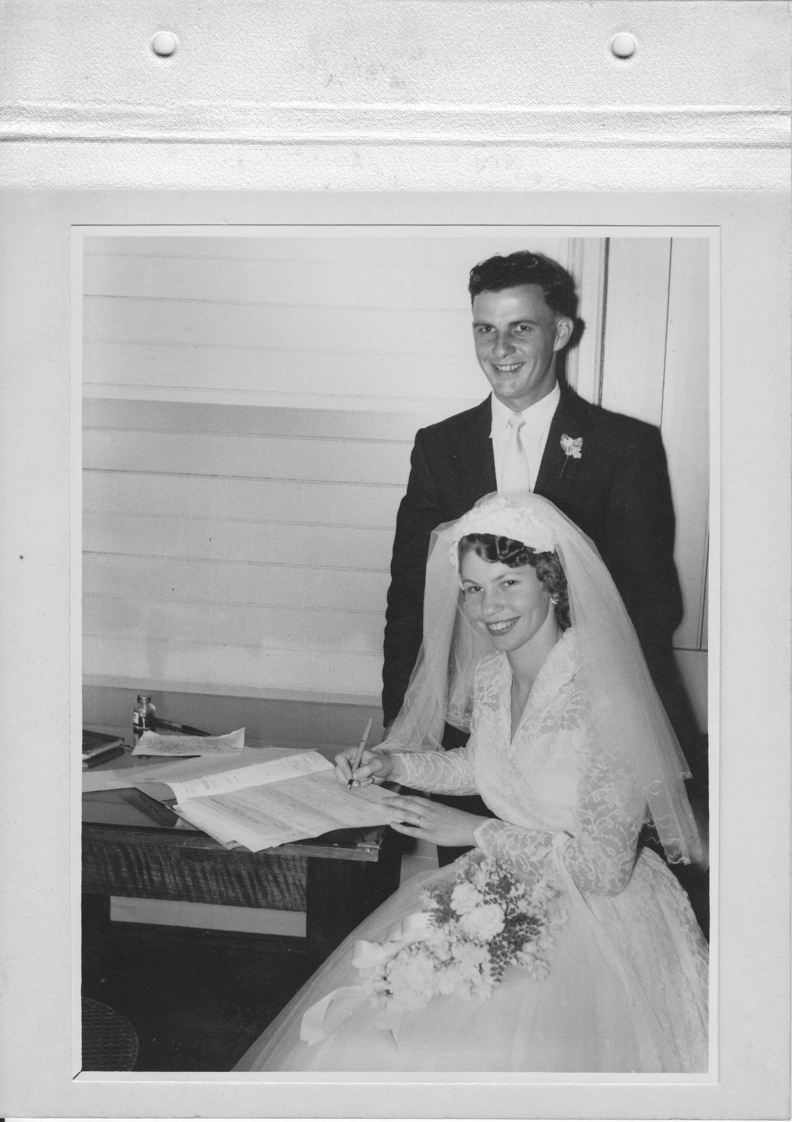
Barry Ronald Dudley – 31 Oct 1936 – 12 Nov 2018

Slide 7
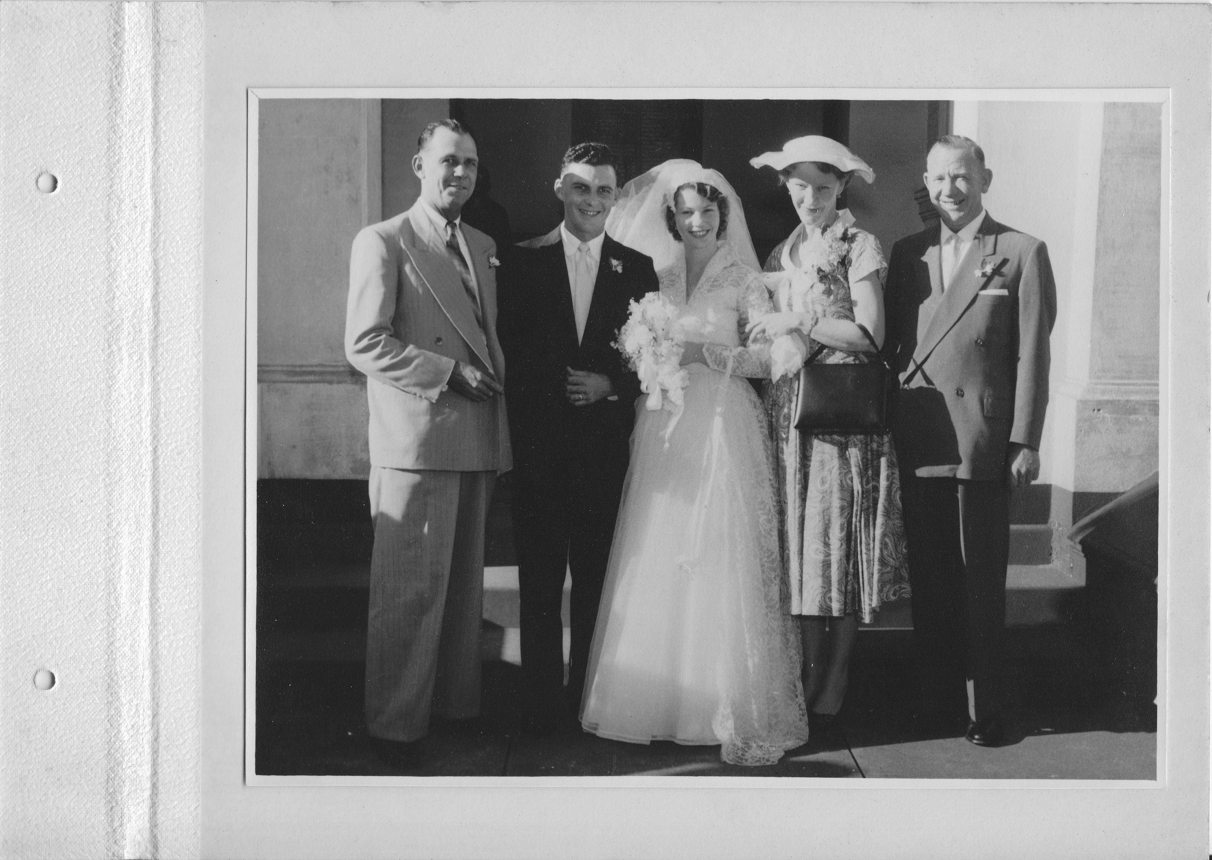
Barry Ronald Dudley – 31 Oct 1936 – 12 Nov 2018

Slide 8
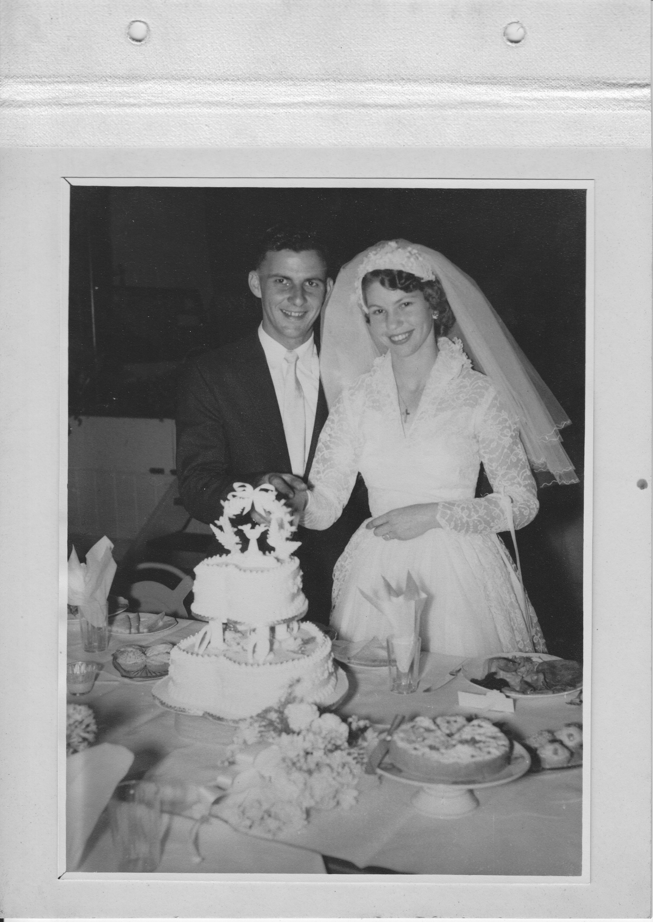
Barry Ronald Dudley – 31 Oct 1936 – 12 Nov 2018

Slide 9
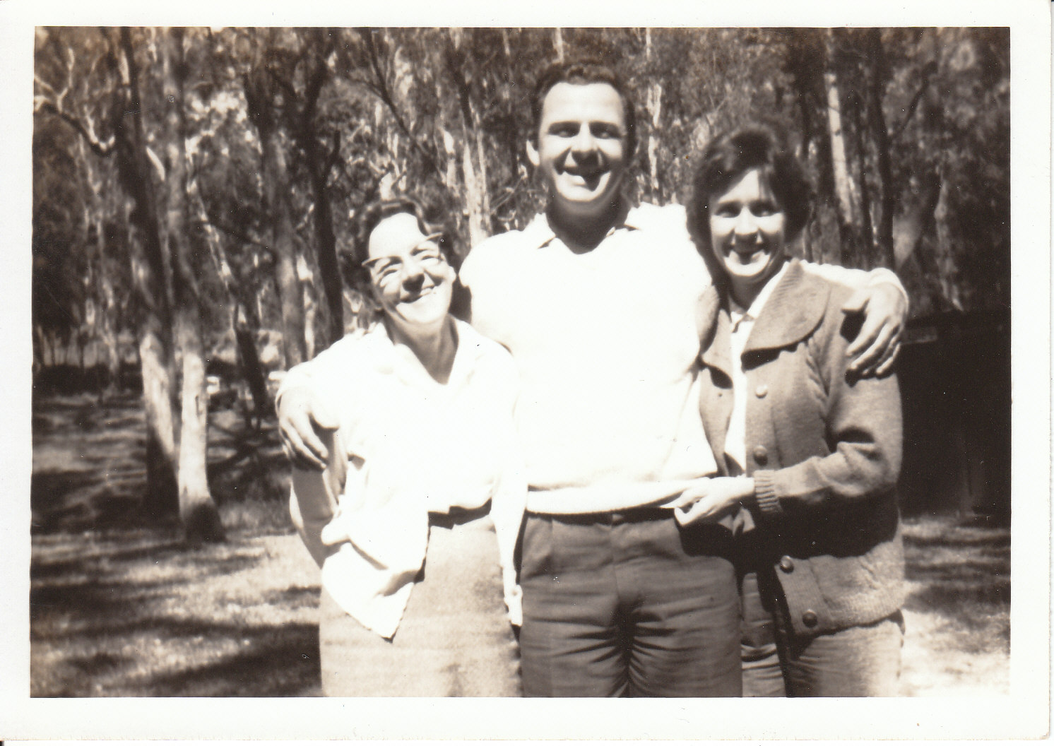
Barry Ronald Dudley – 31 Oct 1936 – 12 Nov 2018

Slide 10
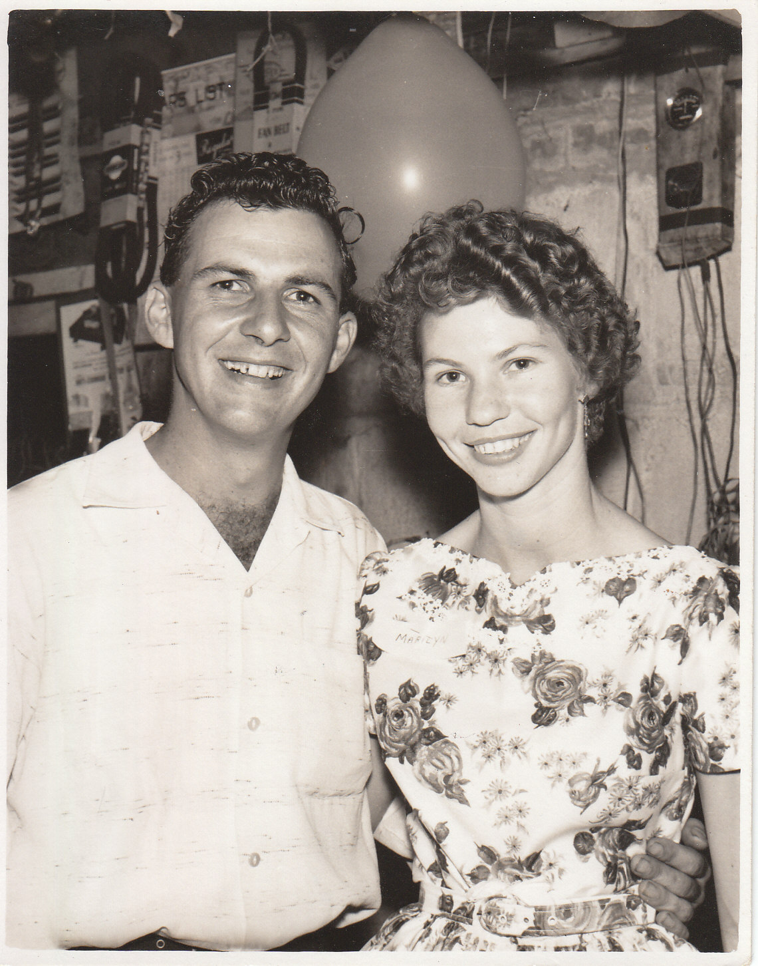
Barry Ronald Dudley – 31 Oct 1936 – 12 Nov 2018

Slide 11
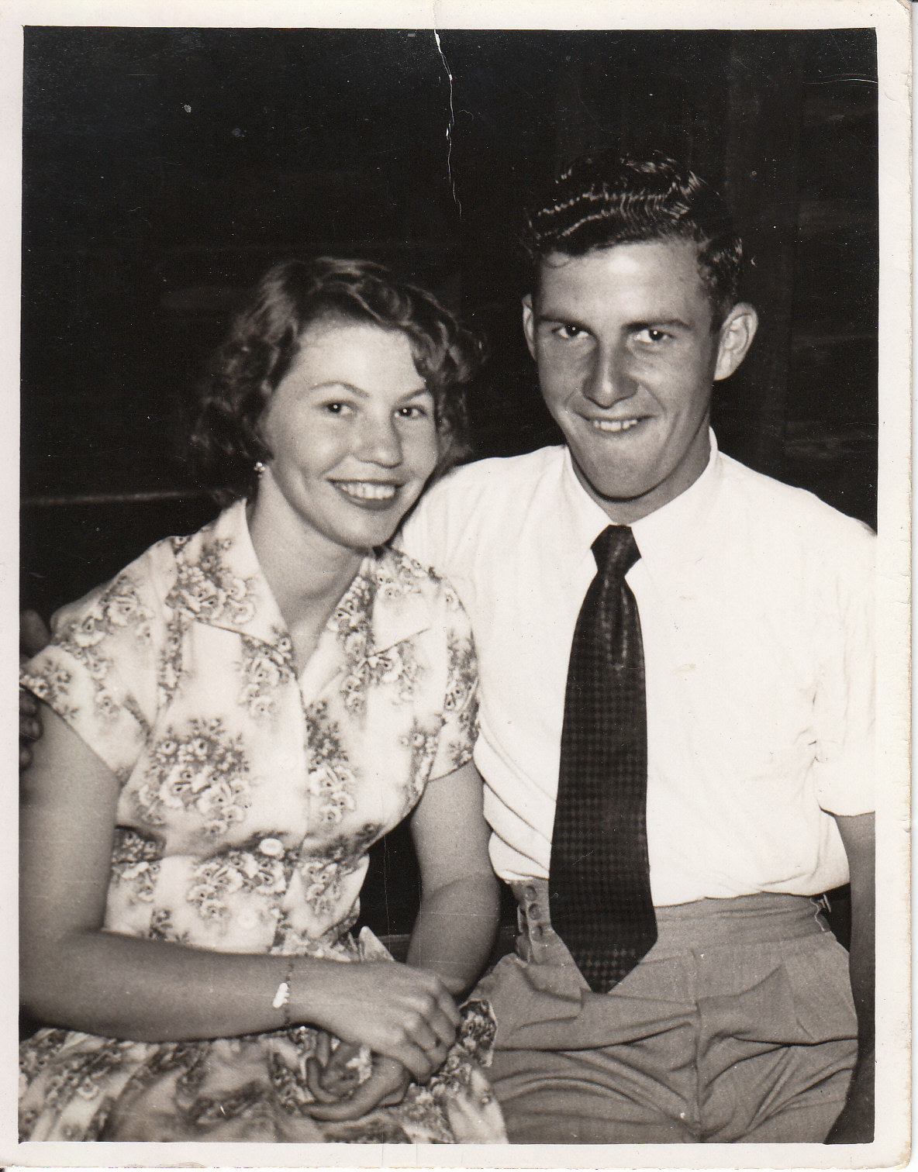
Barry Ronald Dudley – 31 Oct 1936 – 12 Nov 2018

Slide 12
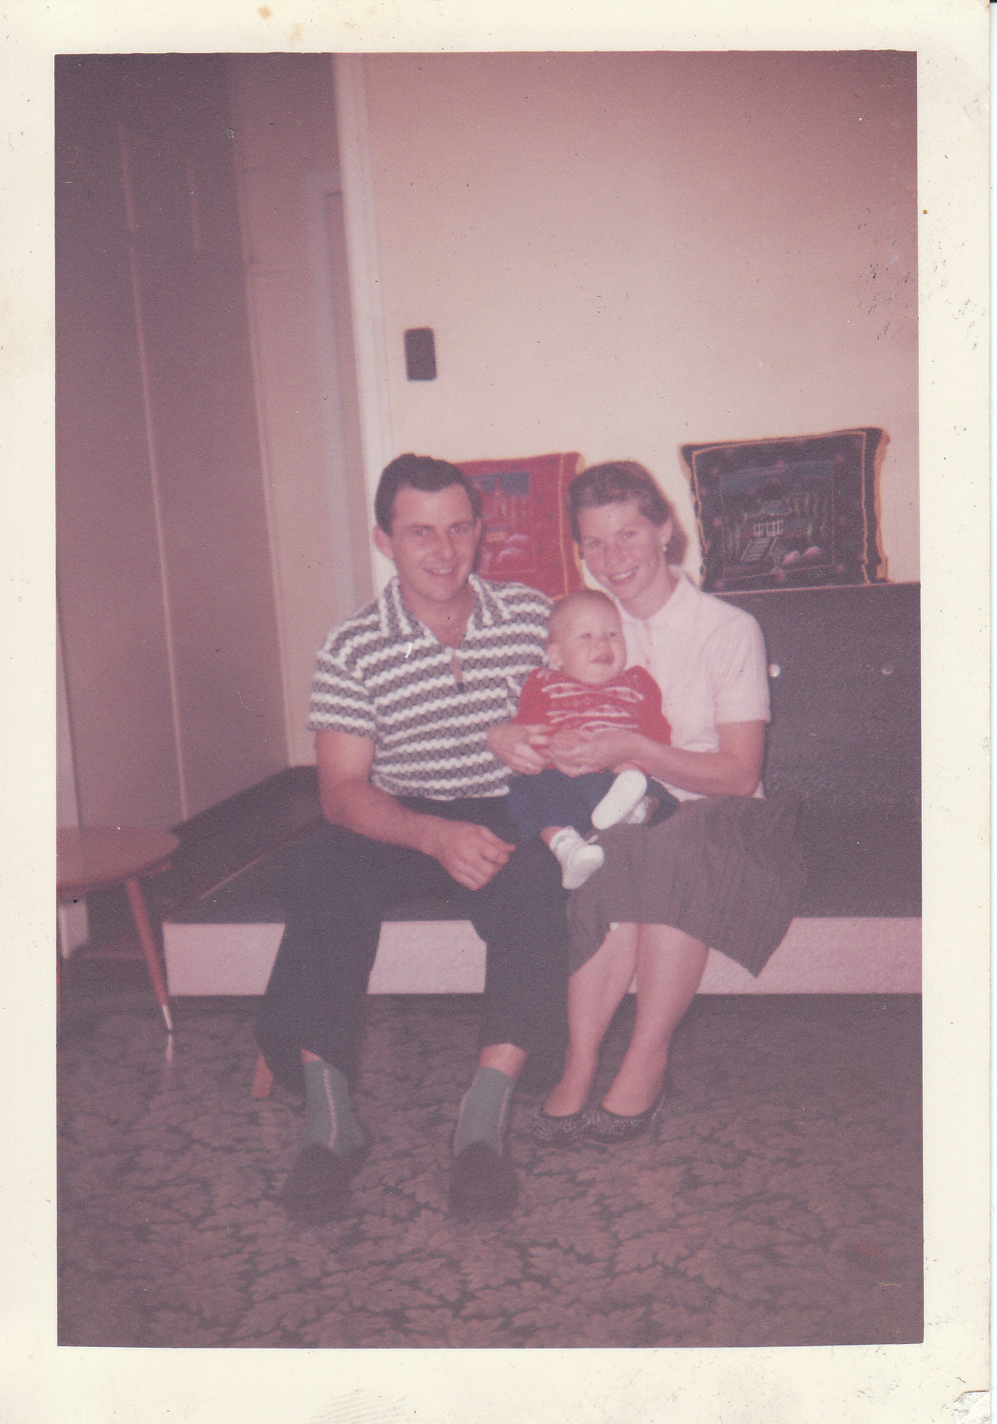
Barry Ronald Dudley – 31 Oct 1936 – 12 Nov 2018

Slide 13
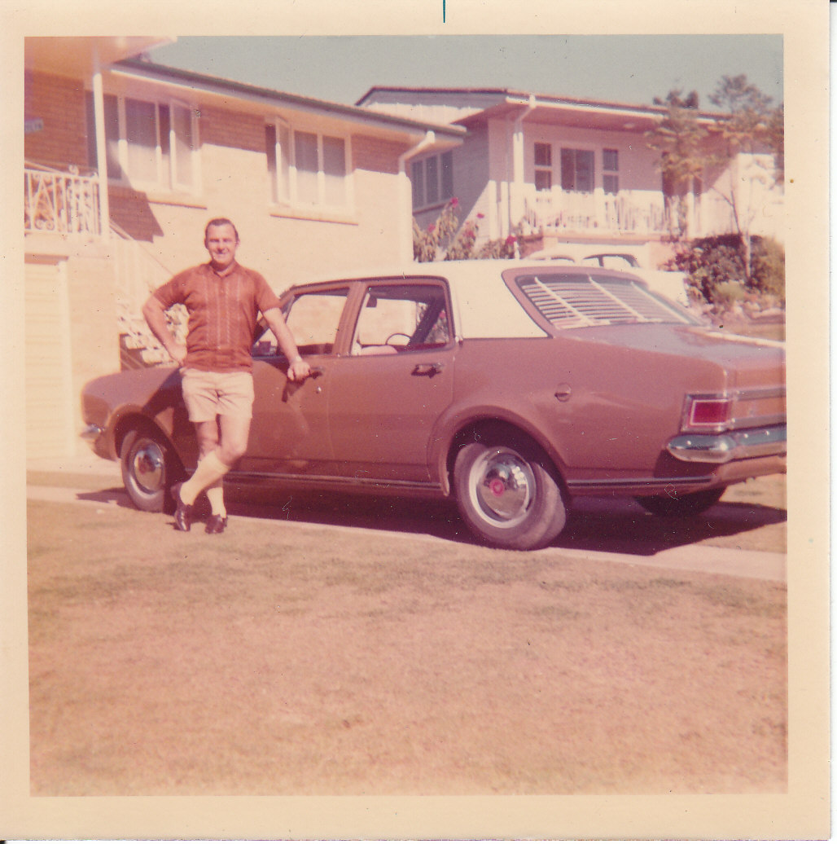
Barry Ronald Dudley – 31 Oct 1936 – 12 Nov 2018

Slide 14
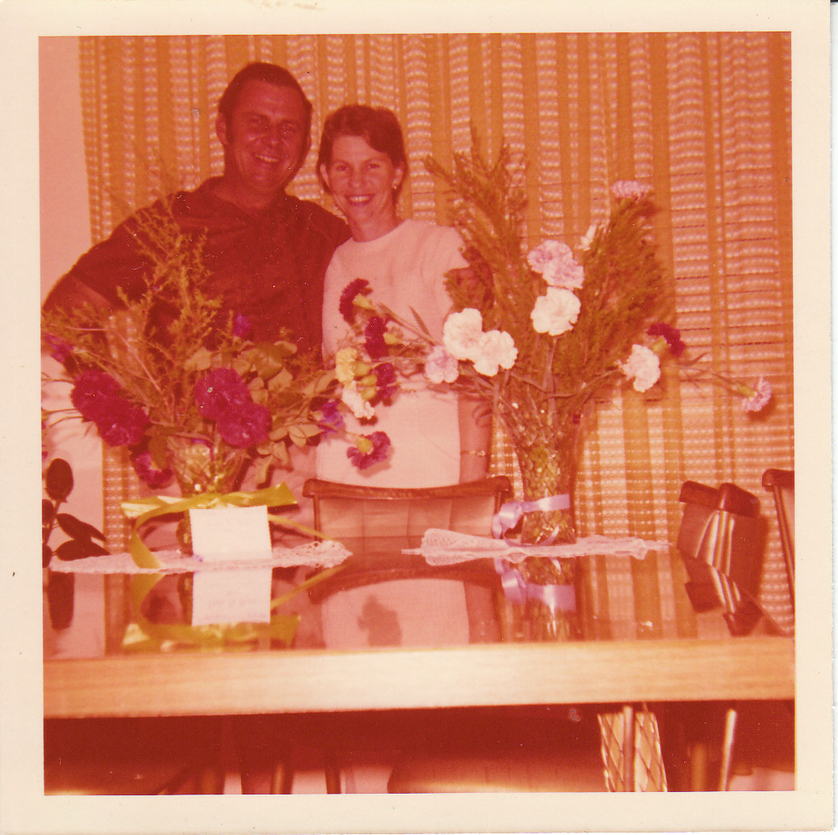
Barry Ronald Dudley – 31 Oct 1936 – 12 Nov 2018

Slide 15
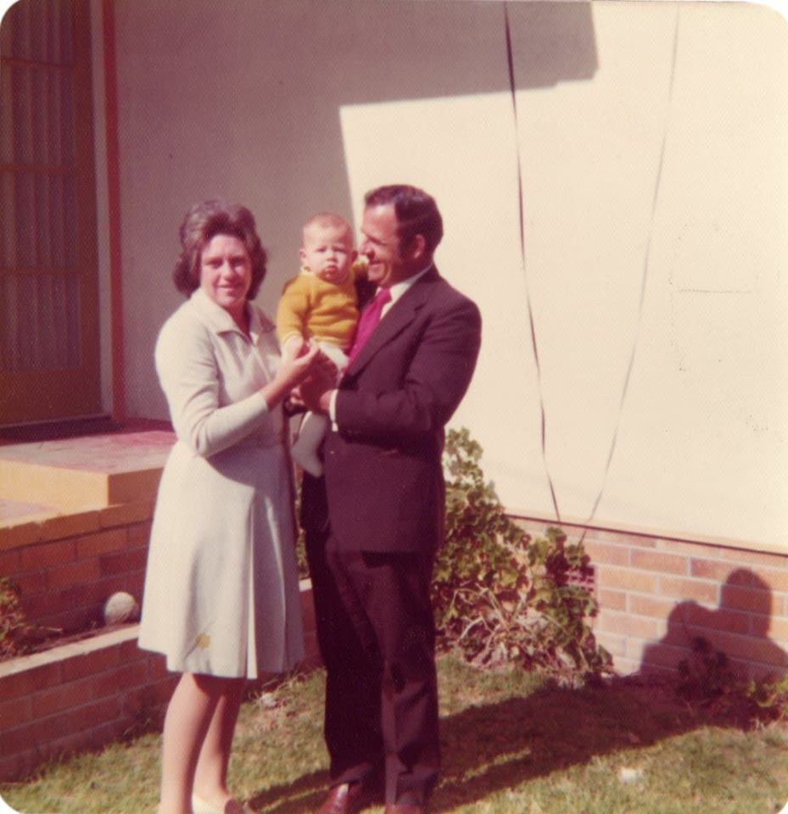
Barry Ronald Dudley – 31 Oct 1936 – 12 Nov 2018

Slide 16
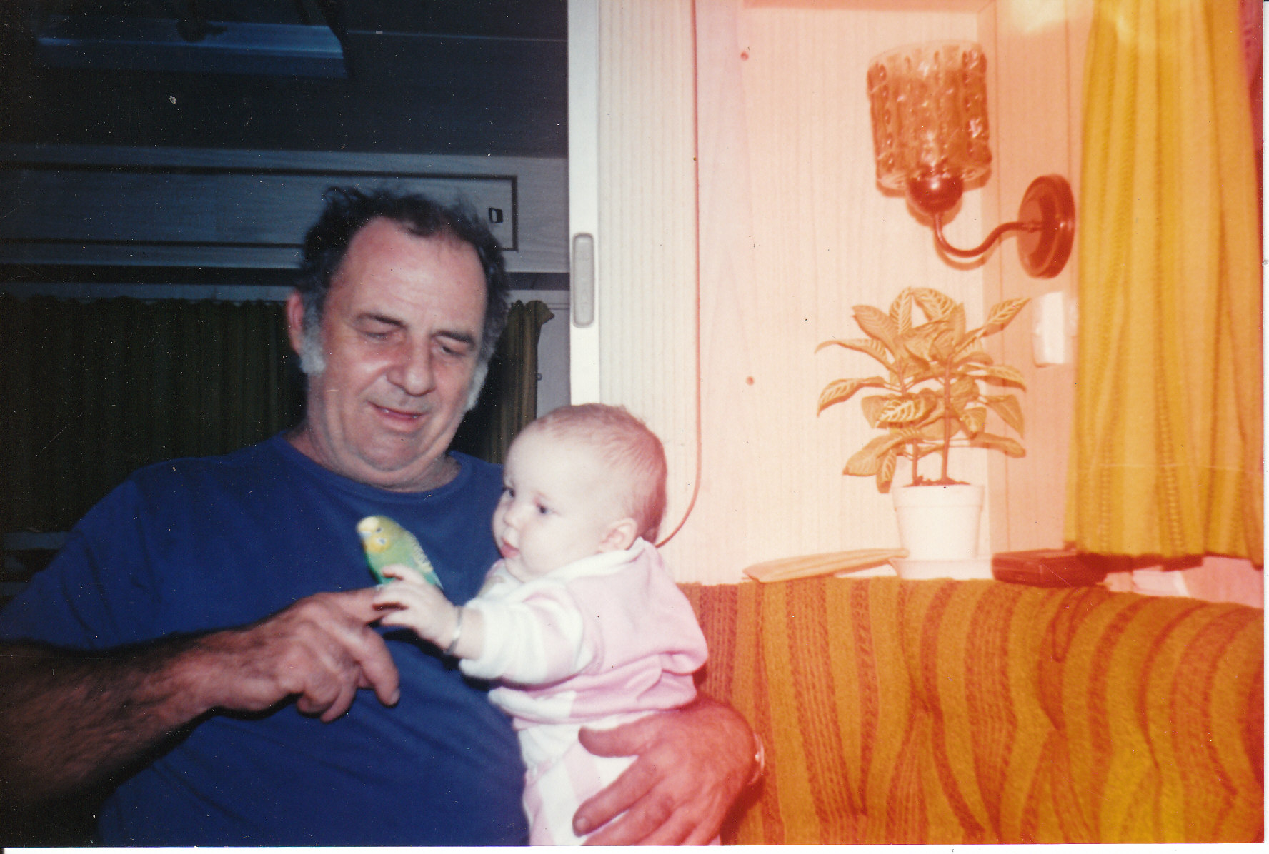
Barry Ronald Dudley – 31 Oct 1936 – 12 Nov 2018

Slide 17
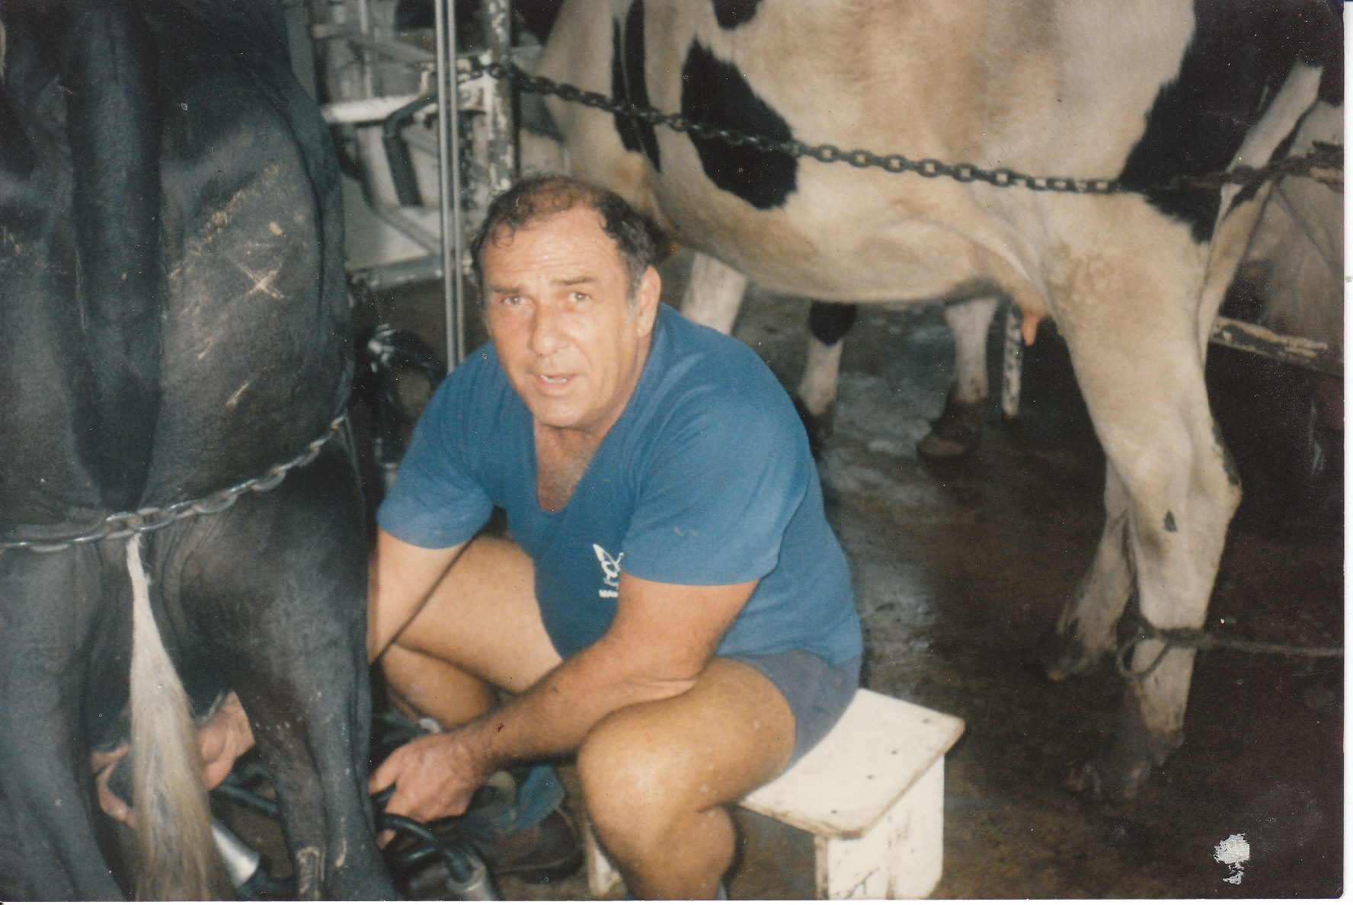
Barry Ronald Dudley – 31 Oct 1936 – 12 Nov 2018

Slide 18
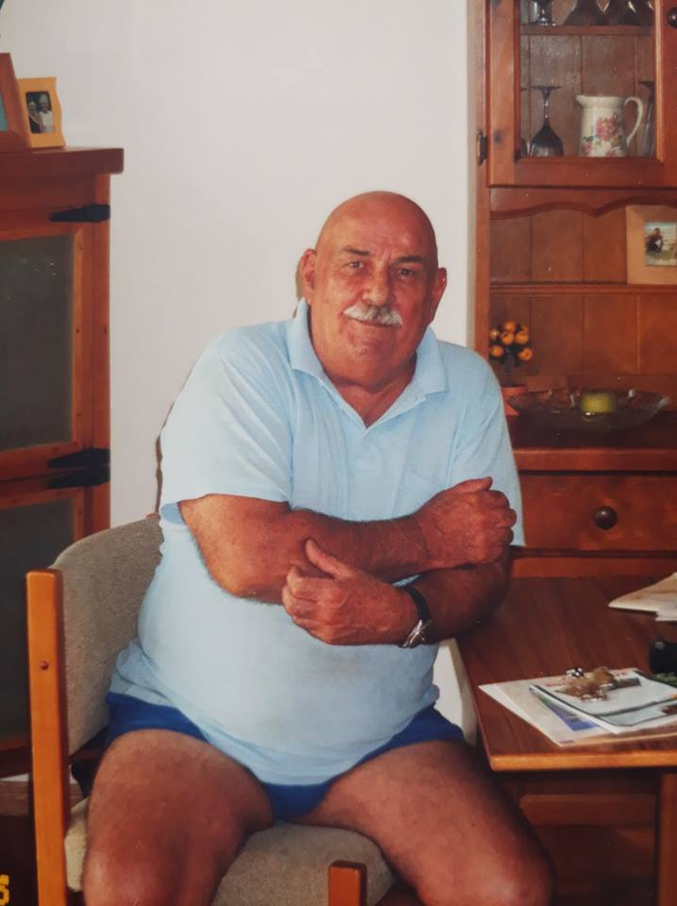
Barry Ronald Dudley – 31 Oct 1936 – 12 Nov 2018

Slide 19
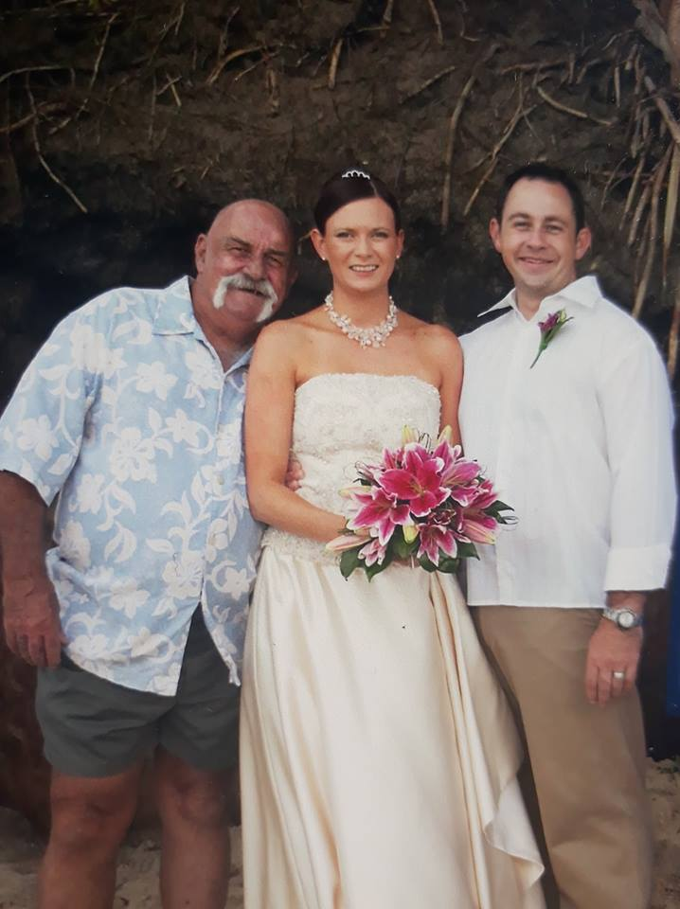
Barry Ronald Dudley – 31 Oct 1936 – 12 Nov 2018

Slide 20
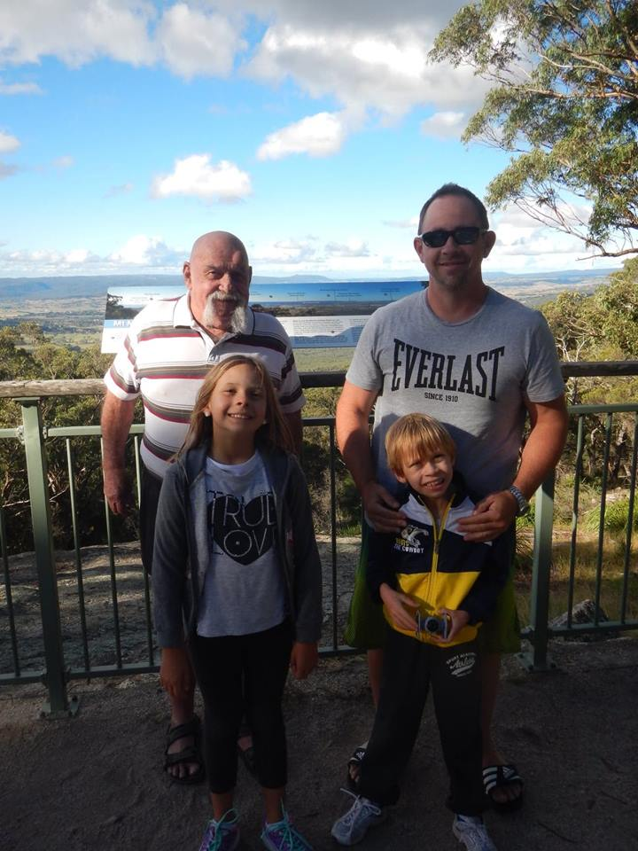
Barry Ronald Dudley – 31 Oct 1936 – 12 Nov 2018

Slide 21
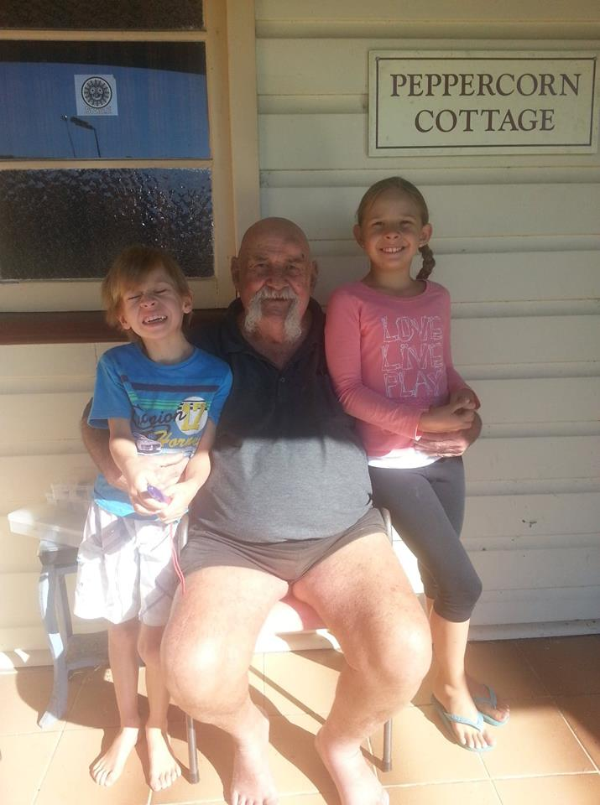
Barry Ronald Dudley – 31 Oct 1936 – 12 Nov 2018

Slide 22
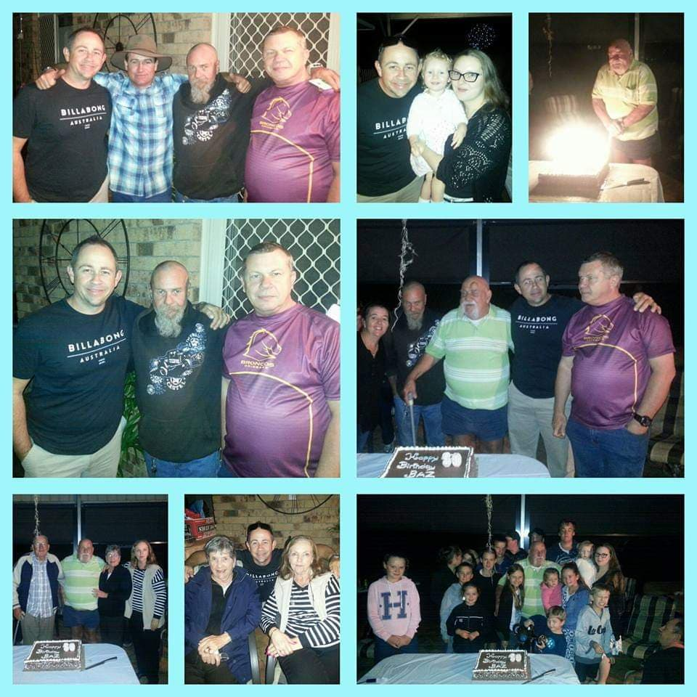
Barry Ronald Dudley – 31 Oct 1936 – 12 Nov 2018

Slide 23
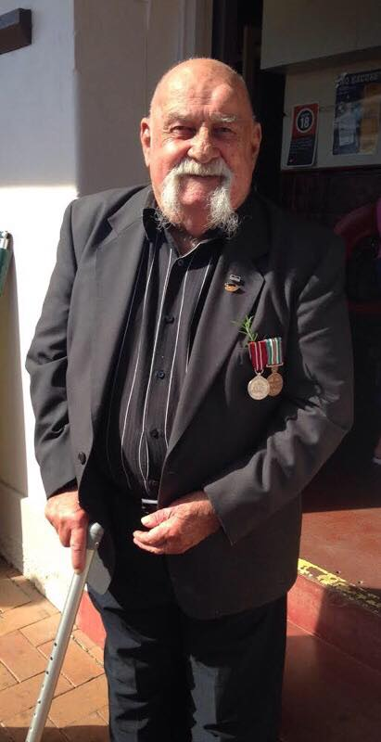
Barry Ronald Dudley – 31 Oct 1936 – 12 Nov 2018

Slide 24
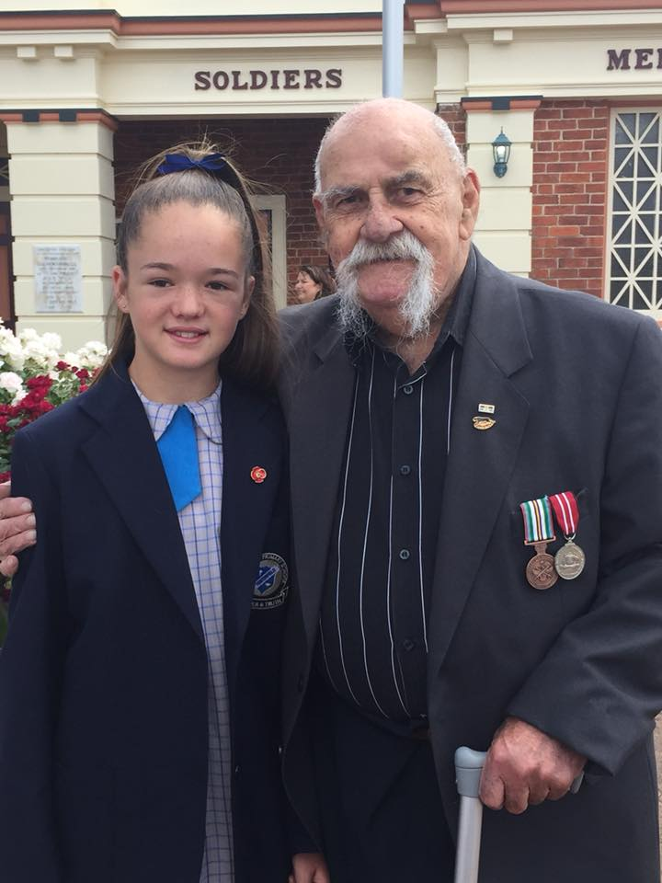
Barry Ronald Dudley – 31 Oct 1936 – 12 Nov 2018

Slide 25
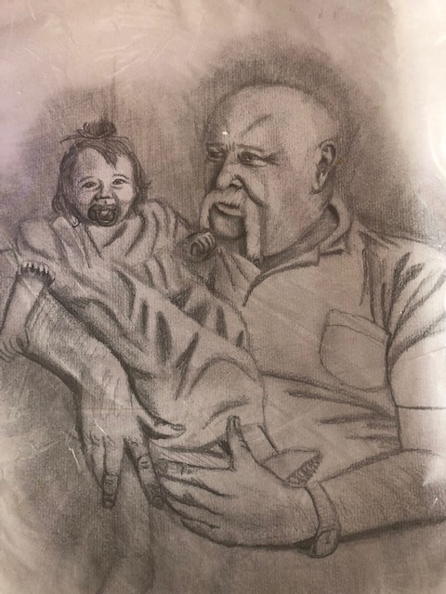
Barry Ronald Dudley – 31 Oct 1936 – 12 Nov 2018

Slide 26
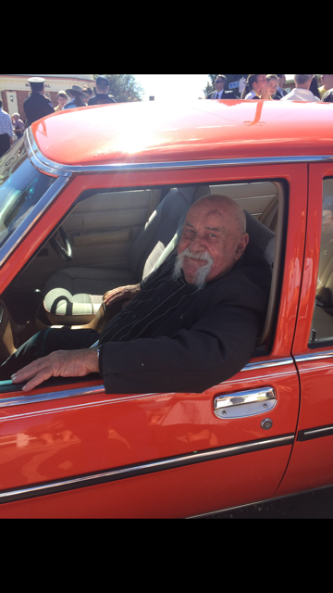
Barry Ronald Dudley – 31 Oct 1936 – 12 Nov 2018

Slide 27
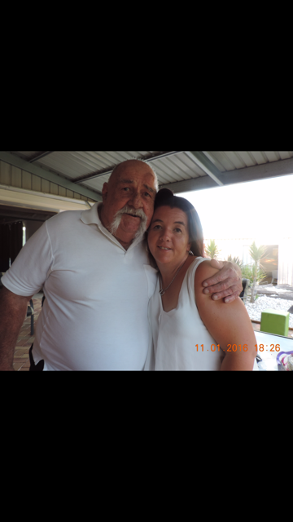
Barry Ronald Dudley – 31 Oct 1936 – 12 Nov 2018

Slide 28
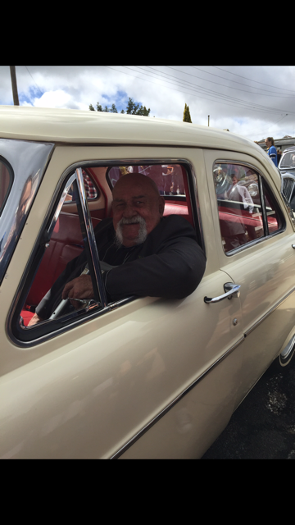
Barry Ronald Dudley – 31 Oct 1936 – 12 Nov 2018

Slide 29
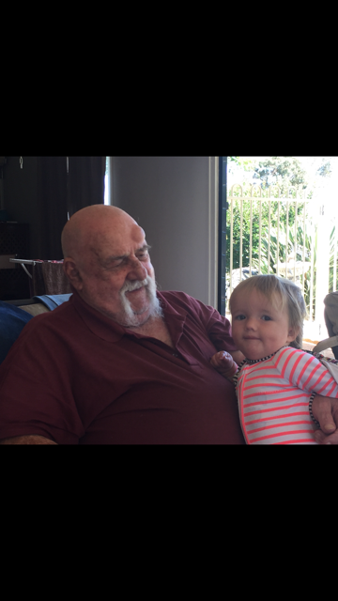
Barry Ronald Dudley – 31 Oct 1936 – 12 Nov 2018

Slide 30
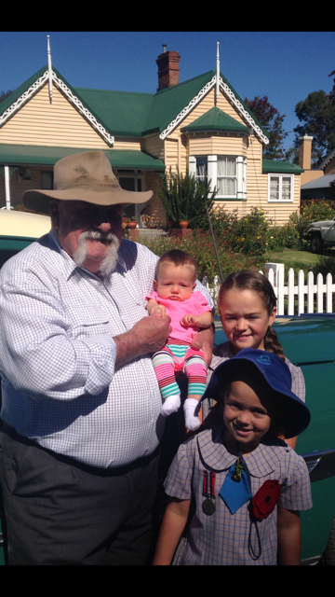
Barry Ronald Dudley – 31 Oct 1936 – 12 Nov 2018

Slide 31
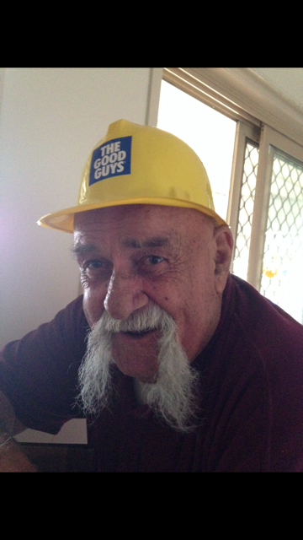
Barry Ronald Dudley – 31 Oct 1936 – 12 Nov 2018

Slide 32
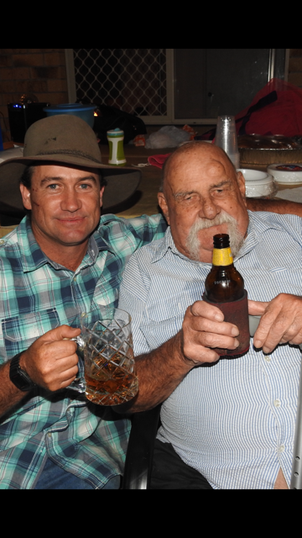
Barry Ronald Dudley – 31 Oct 1936 – 12 Nov 2018

Slide 33
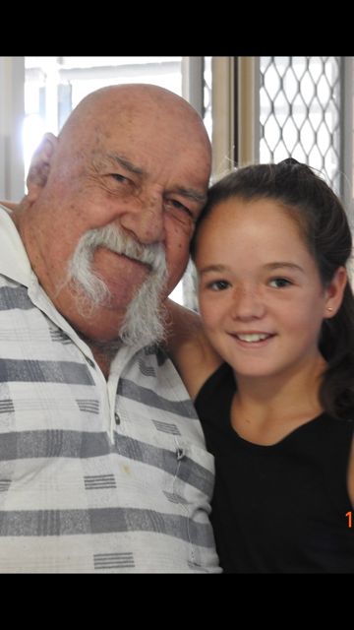
Barry Ronald Dudley – 31 Oct 1936 – 12 Nov 2018

Slide 34
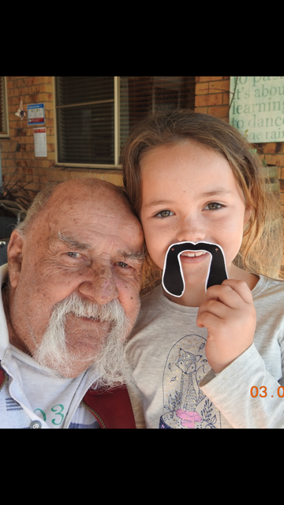
Barry Ronald Dudley – 31 Oct 1936 – 12 Nov 2018

Slide 35
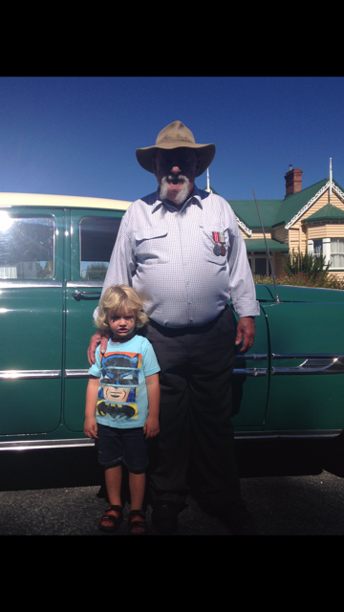
Barry Ronald Dudley – 31 Oct 1936 – 12 Nov 2018

Slide 36
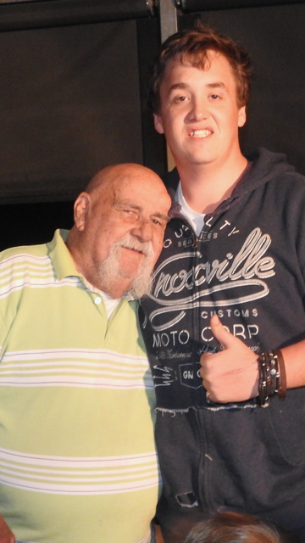
Barry Ronald Dudley – 31 Oct 1936 – 12 Nov 2018

Slide 37
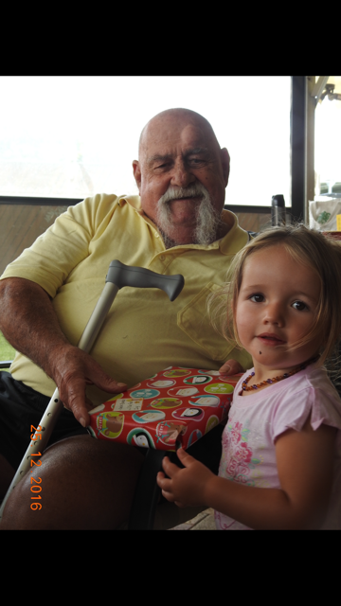
Barry Ronald Dudley – 31 Oct 1936 – 12 Nov 2018

Slide 38
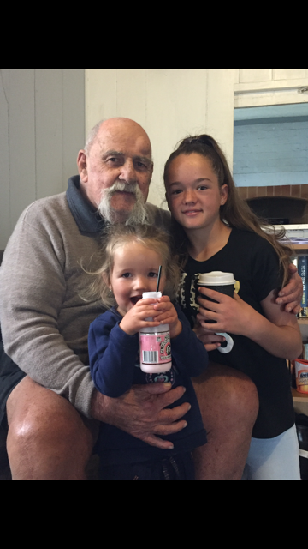
Barry Ronald Dudley – 31 Oct 1936 – 12 Nov 2018

Slide 39
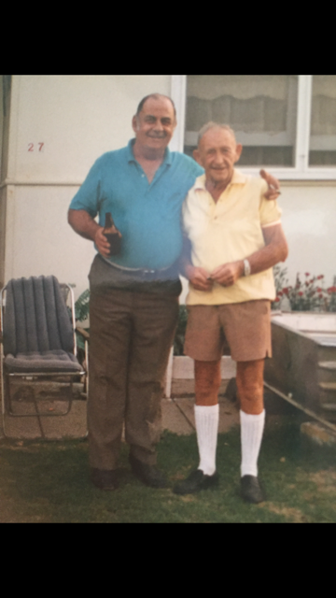
Barry Ronald Dudley – 31 Oct 1936 – 12 Nov 2018

Slide 40
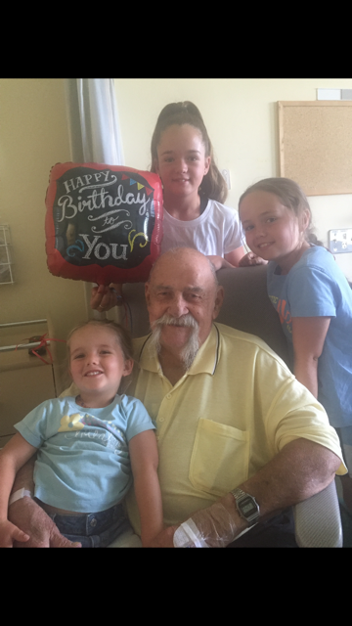
Barry Ronald Dudley – 31 Oct 1936 – 12 Nov 2018

Slide 41
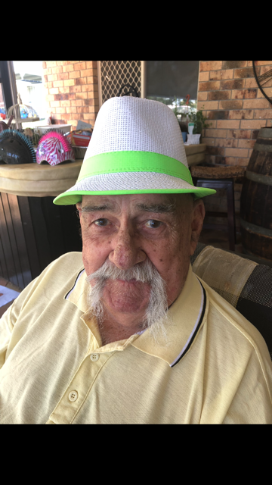
Barry Ronald Dudley – 31 Oct 1936 – 12 Nov 2018

Slide 42
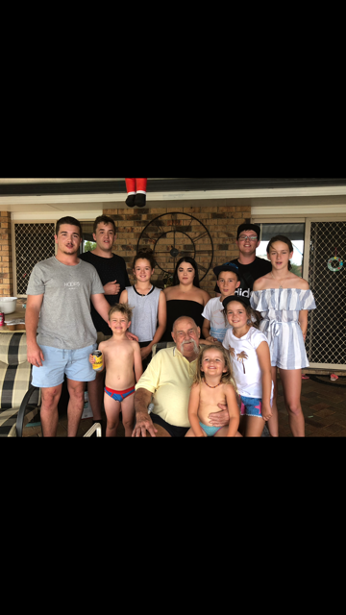
Barry Ronald Dudley – 31 Oct 1936 – 12 Nov 2018

Slide 43
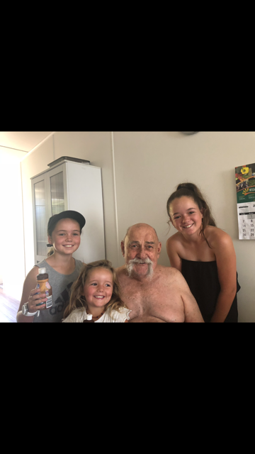
Barry Ronald Dudley – 31 Oct 1936 – 12 Nov 2018

Slide 44
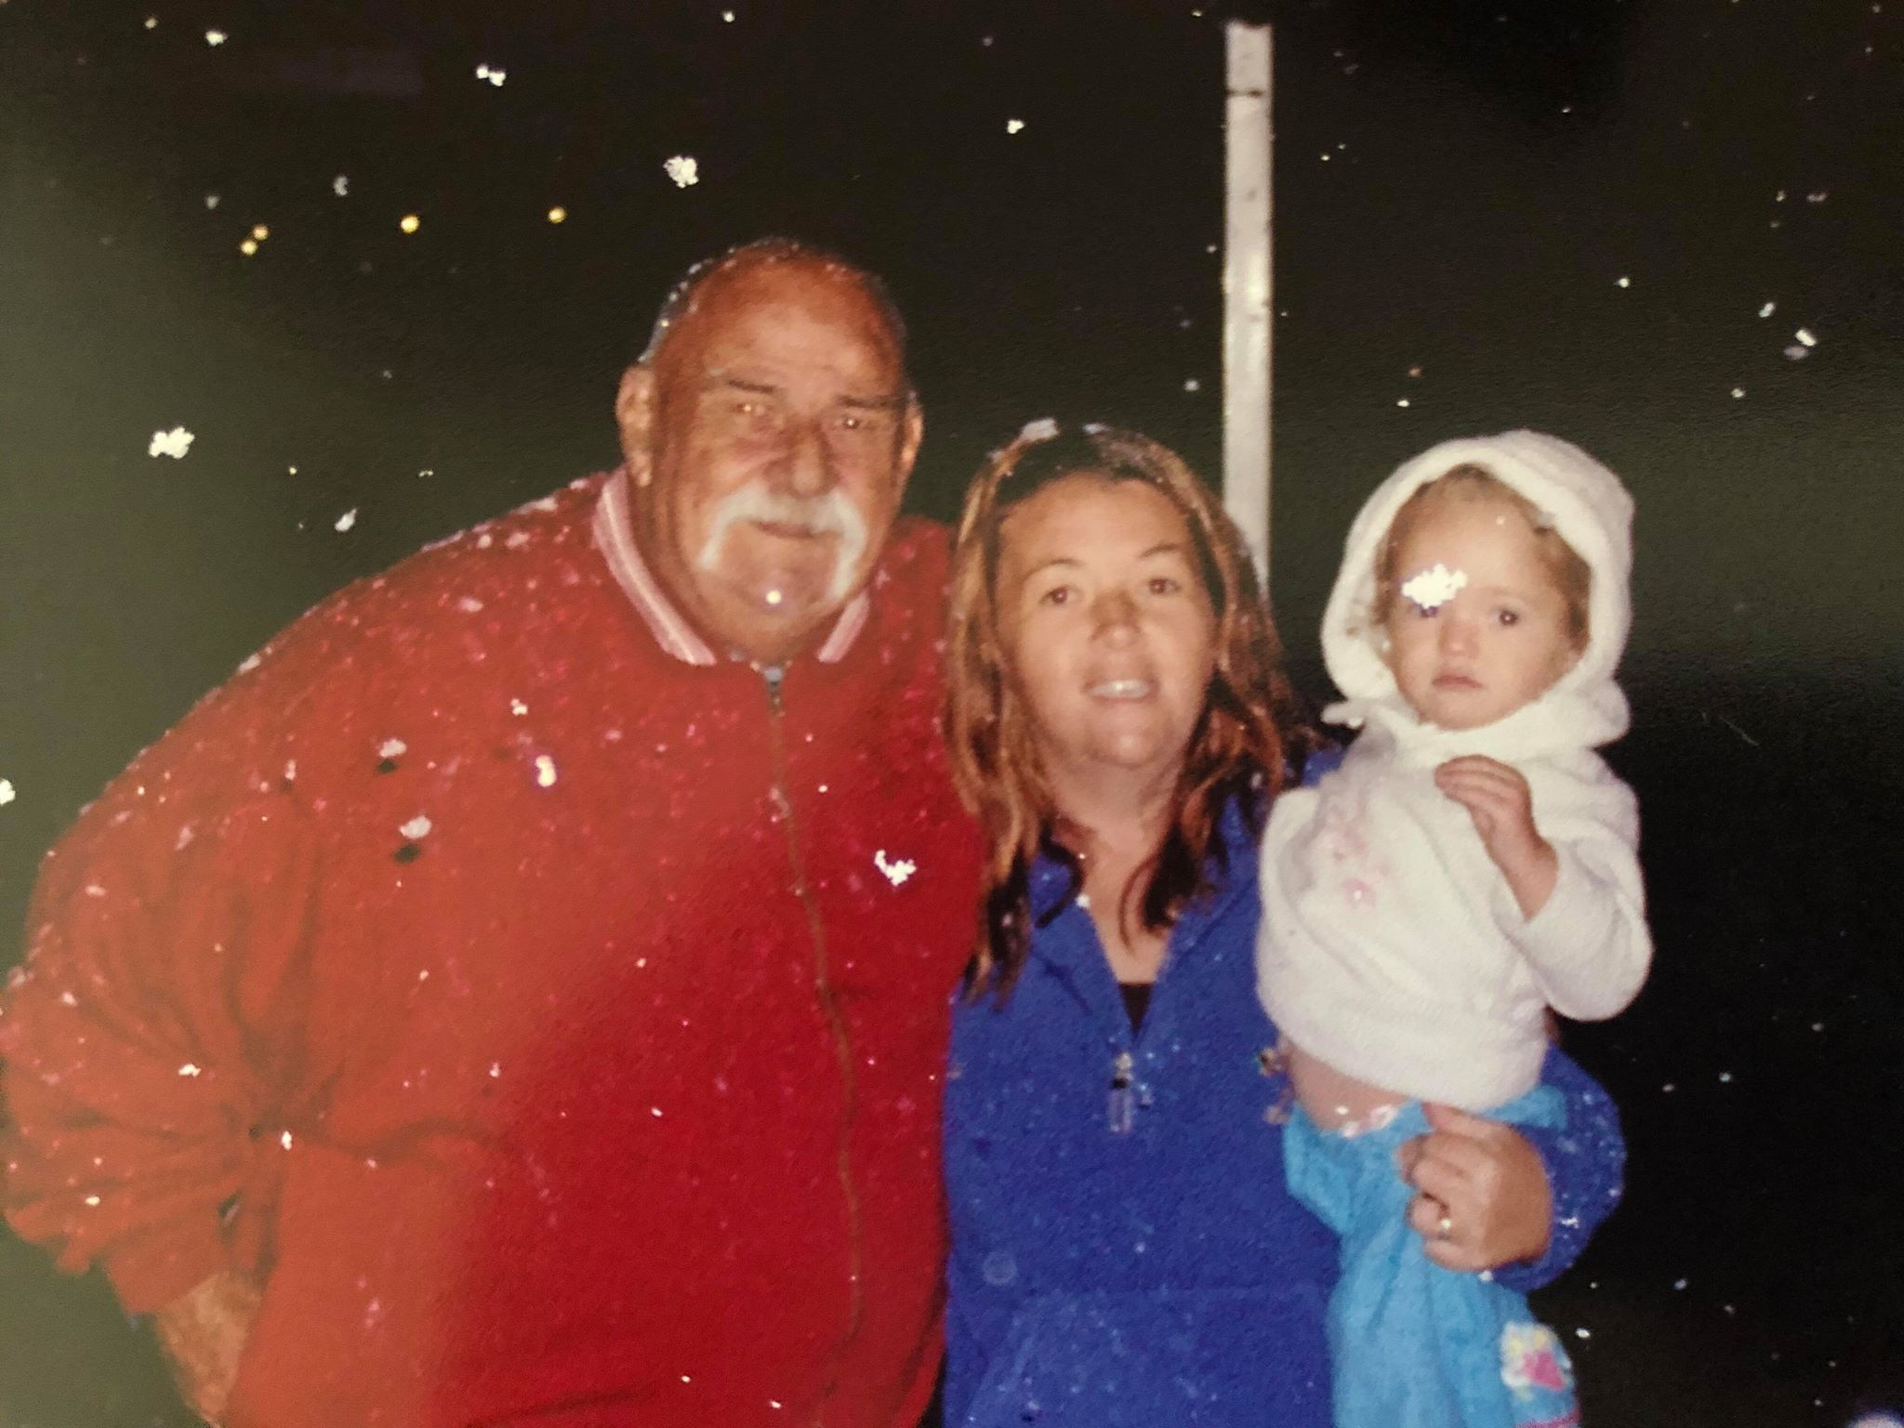
Barry Ronald Dudley – 31 Oct 1936 – 12 Nov 2018

Slide 45
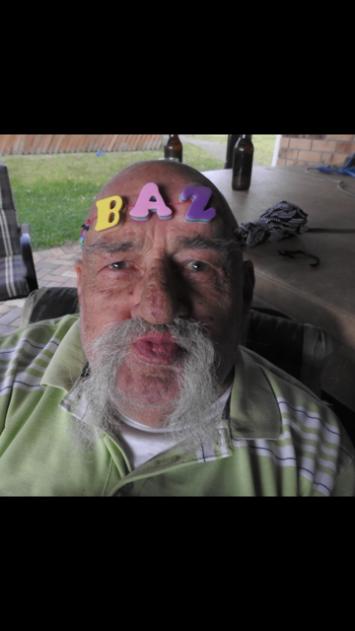
Barry Ronald Dudley – 31 Oct 1936 – 12 Nov 2018

Slide 46
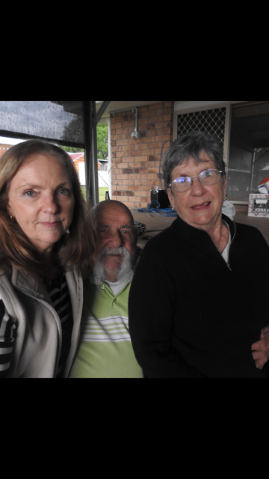
Barry Ronald Dudley – 31 Oct 1936 – 12 Nov 2018

Slide 47
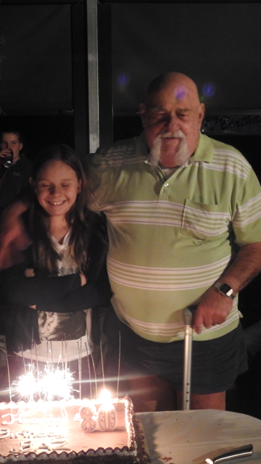
Barry Ronald Dudley – 31 Oct 1936 – 12 Nov 2018

Slide 48
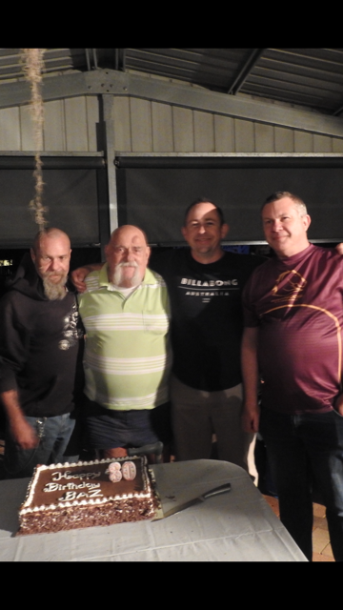
Barry Ronald Dudley – 31 Oct 1936 – 12 Nov 2018

Slide 49

Barry Ronald Dudley – 31 Oct 1936 – 12 Nov 2018

Slide 50

Barry Ronald Dudley – 31 Oct 1936 – 12 Nov 2018

Slide 51

Barry Ronald Dudley – 31 Oct 1936 – 12 Nov 2018

Slide 52

Barry Ronald Dudley – 31 Oct 1936 – 12 Nov 2018

Slide 53

Barry Ronald Dudley – 31 Oct 1936 – 12 Nov 2018

Slide 54

Barry Ronald Dudley – 31 Oct 1936 – 12 Nov 2018

Slide 55

Barry Ronald Dudley – 31 Oct 1936 – 12 Nov 2018

Slide 56

Barry Ronald Dudley – 31 Oct 1936 – 12 Nov 2018

Slide 57

Barry Ronald Dudley – 31 Oct 1936 – 12 Nov 2018

Slide 58

Barry Ronald Dudley – 31 Oct 1936 – 12 Nov 2018

Slide 59

Barry Ronald Dudley – 31 Oct 1936 – 12 Nov 2018

Slide 60

Barry Ronald Dudley – 31 Oct 1936 – 12 Nov 2018

Slide 61

Barry Ronald Dudley – 31 Oct 1936 – 12 Nov 2018

Slide 62

Barry Ronald Dudley – 31 Oct 1936 – 12 Nov 2018

Slide 63

Barry Ronald Dudley – 31 Oct 1936 – 12 Nov 2018

Slide 64

Barry Ronald Dudley – 31 Oct 1936 – 12 Nov 2018

Slide 65

Barry Ronald Dudley – 31 Oct 1936 – 12 Nov 2018

Slide 66

Barry Ronald Dudley – 31 Oct 1936 – 12 Nov 2018

